Slide 1

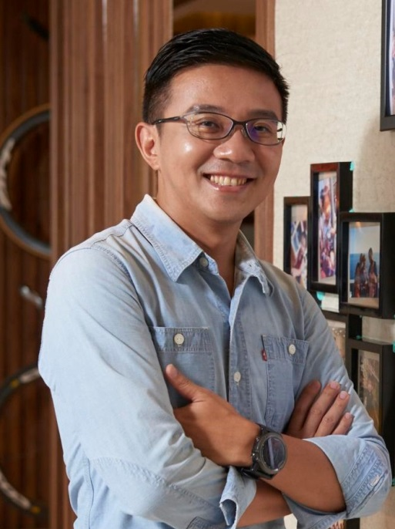

創業家應有的思維
The Mindset as an Entrepreneur
Johnny Huang
執行副總裁级
Executive Field Vice-President
四個佣金週期共賺取HK$345,000
HK$345,000 in 4 Commission weeks
本簡報中提到的收入等級純屬舉例說明，無意代表美安香港超連鎖™店主的一般收入，也無意表示任何超連鎖™店主皆可賺取同等收入。美安香港超連鎖™店主的成功與否，取決於其在發展事業時的努力、才能與投入程度。
The income levels mentioned in the following presentation are for illustration purposes only. They are not intended to represent the income of a typical Market Hong Kong UnFranchise ™Owner, nor are they intended to represent that any given Independent UnFranchise ™ Owner will earn income in that amount. The success of any Market Hong Kong Independent UnFranchise ™ Owner will depend upon the amount of hard work, talent, and dedication which he or she devotes to building his or her Market Hong Kong Business.

Slide 2




FOLLOW ME ON SOCIAL MEDIA
facebook.com/johnny1122tw

Slide 3
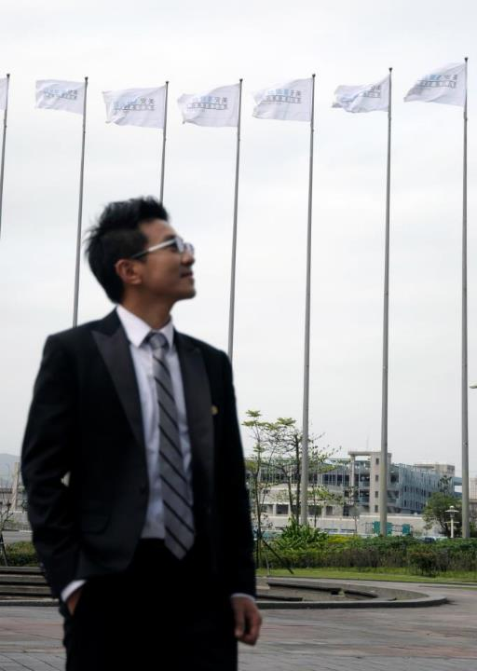

Johnny Huang
Executive Field Vice-President HK$345,000/4 weeks
Worked in Finance and Insurance Company for 9 years
Being promoted to Manager at 27
Became UFO in Nov. 2006
Former ~Local Coordinator of Taipei (South)
~Fund Management Committee
Current member of
~Taipei Leadership Council(TLC)
~Million Dollar Club
~International Advisory Council Member
3
本簡報中提到的收入等級純屬舉例說明，無意代表美安香港超連鎖™店主的一般收入，也無意表示任何超連鎖™店主皆可賺取同等收入。美安香港超連鎖™店主的成功與否，取決於其在發展事業時的努力、才能與投入程度。
The income levels mentioned in the following presentation are for illustration purposes only. They are not intended to represent the income of a typical Market Hong Kong UnFranchise ™Owner, nor are they intended to represent that any given Independent UnFranchise ™ Owner will earn income in that amount. The success of any Market Hong Kong Independent UnFranchise ™ Owner will depend upon the amount of hard work, talent, and dedication which he or she devotes to building his or her Market Hong Kong Business.
Notes:
3

Slide 4


Slide 5
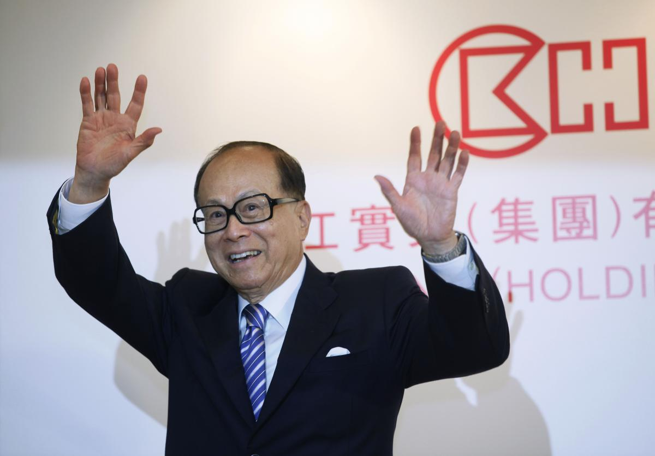

Slide 6
Life would be bitter
but it does not last forever
Some people escape from hardship at this moment
but they suffer for their whole lives
~Ka-shing Li

Slide 7
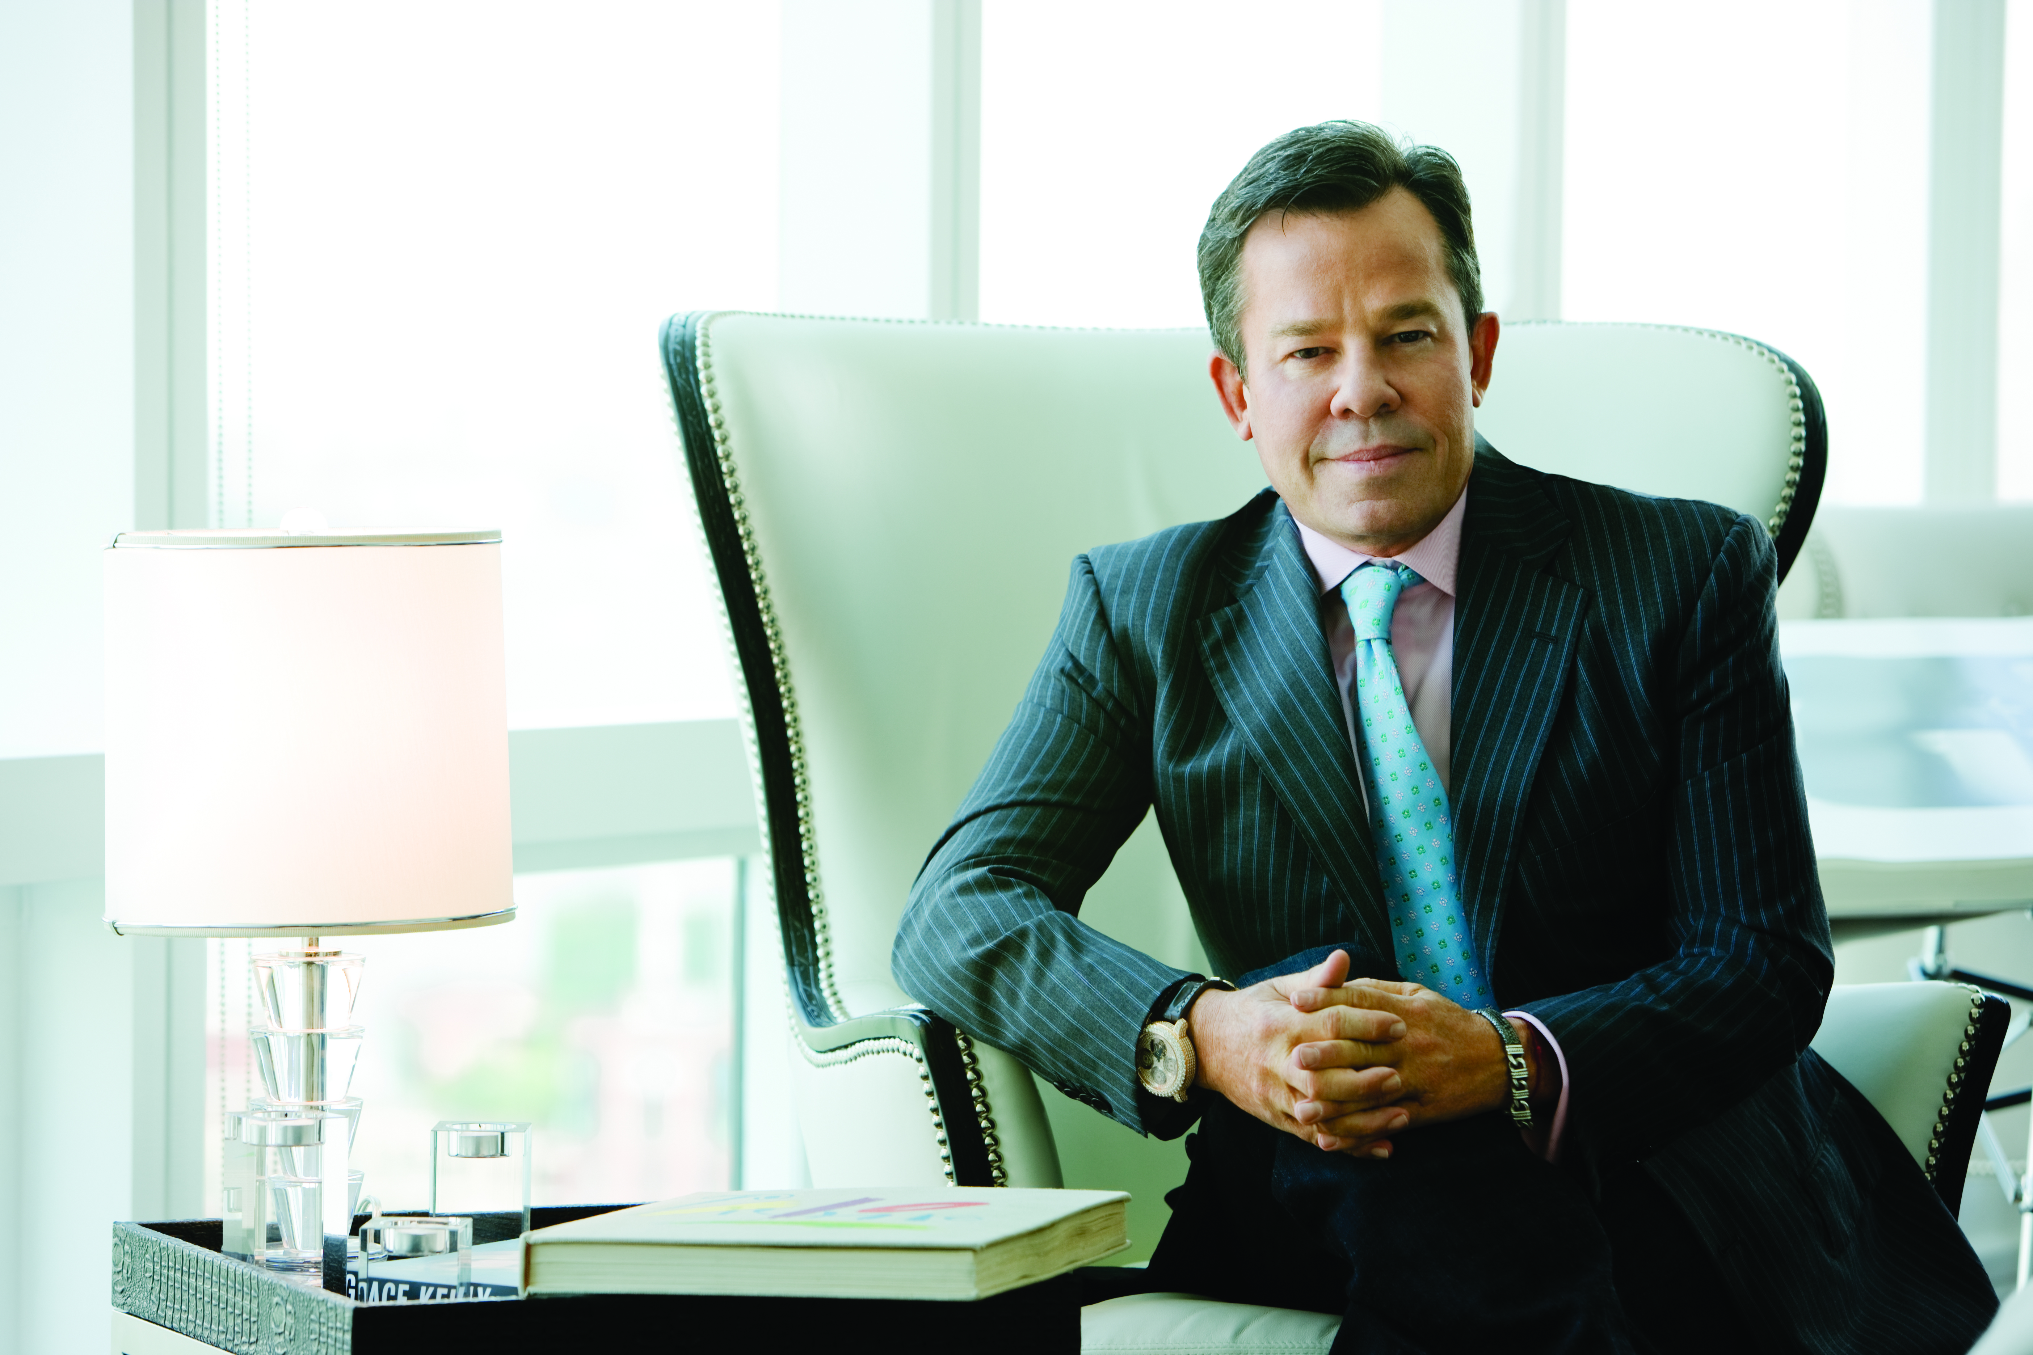
Practice what you preach
You have to success, to help others make their dreams come true.
- JR Ridinger

Slide 8
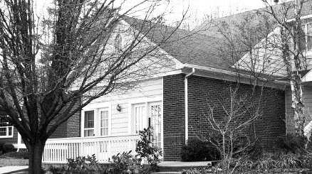


Product agency
No-brick mall
Outmoded products
Market America
1-to-1 marketing
UnFranchiseTMSystem
Hard sell
Industrial deadlock
Competitions
Management Performance
Compensation Plan
SHOP.COM四大基石

Slide 9
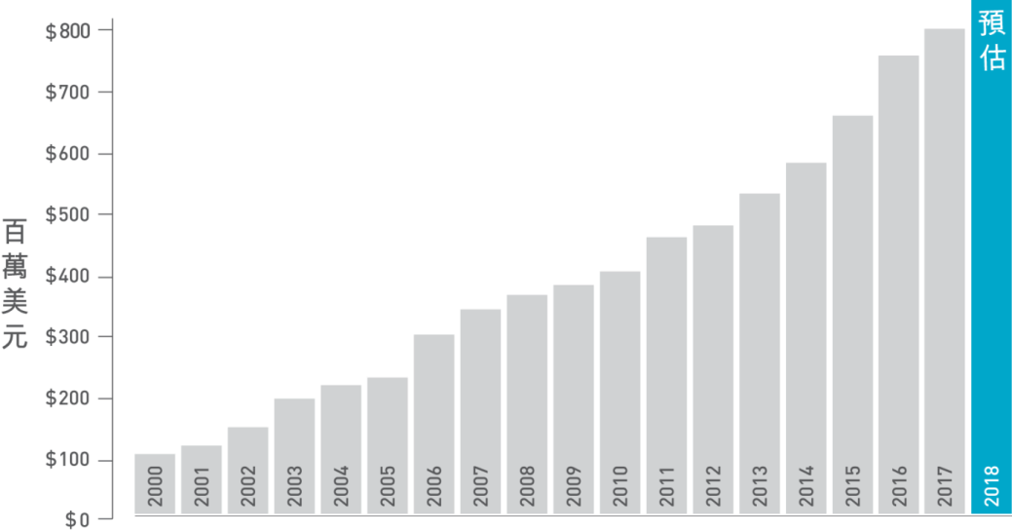

Market America Worldwide Sales Growth
Estimated accumulated sales performance†:
HK$63,731,155,839
+
=
Total UuFranchise Owners Earnings**:
HK$33,092,409,601
Total UnFranchise Owner Commissions*:
HK$16,686,842,896
Total Commissions Earned:
HK$16,405,566,705
**In the end of calendar year 2017 (since the company inception) *Estimated retail profits are based on suggested retail price
†Estimated retail profits are based on suggested retail price

Slide 10
SHOP.COM perfectly presents a 4-win concept
Accelerate the formation of a new economy mode
Market America
Partner
Stores
UnFranchise
Owners
Preferred Customers

Slide 11

The REASON
why you are here
Increase income
Reduce debts
Time freedom
Early retirement
Insurance

Slide 12
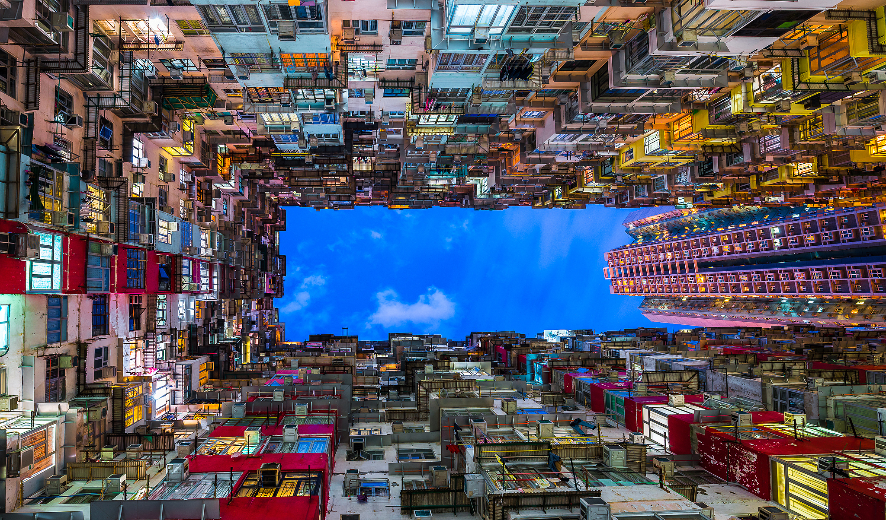

Slide 13
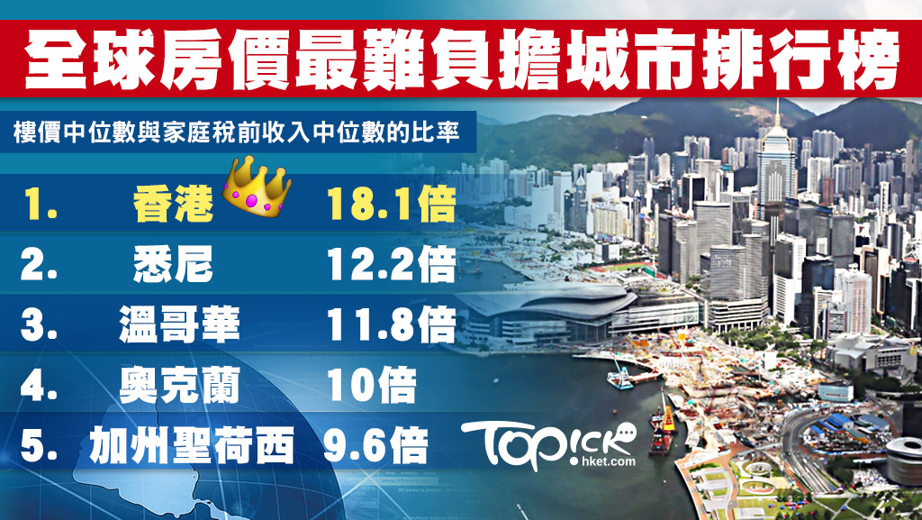
The 5 Most Expensive Cities In The World For Real Estate
Rate of Median house price and Family income
Hong Kong 18.1 Times
Sydney 12.2 Times
Vancouver 11.8 Times
Auckland 10 Times
San Jose, California 9.6 Times

Slide 14
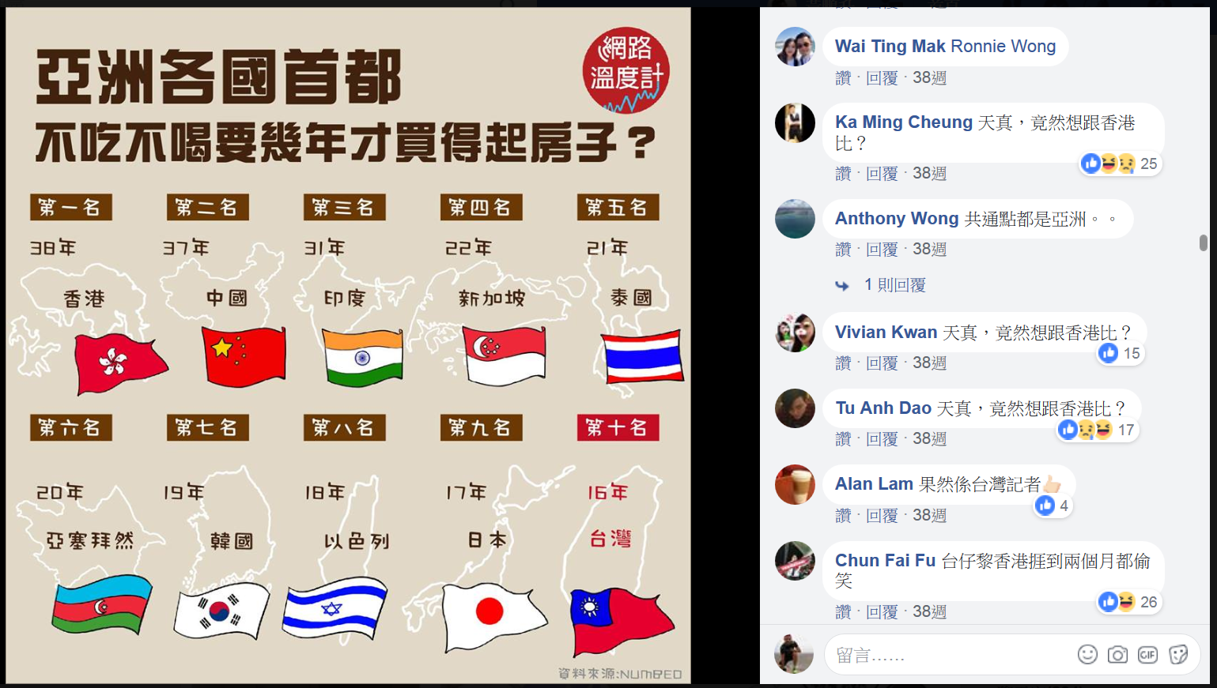

Without any expenditure, how long you have to take for buying a house in Asian capital?
Hong Kong
China
India
Singapore
Thailand
How dare you compare with Hong Kong?!
Azerbaijan
Korea
Israel
Japan
Taiwan

Slide 15

45 year Traditional Plan
Average debts**:
Mortgage$403,430(per family)*
Student grant loans$50,571*
Credit card$43,604(per family)*
*www.censtatd.gov.hk **www.gov.hk
MyGovHK
Notes:
http://www.censtatd.gov.hk/hkstat/sub/so20_tc.jsp
http://gia.info.gov.hk/general/201501/21/P201501210479_0479_140926.pdf
http://www.wfsfaa.gov.hk/sfo/en/postsecondary/nlsps/further/statistics.htm

Slide 16

Rich Dad . Poor Dad
EEmployee
BBusiness man
Professional, Ability
System
(people)
SSelf-employee
$(Money)
IInvestor
(Doctor, Lawyer)

Slide 17

Non-salary income…
Searching for …Financial Freedom!
then you can get…Time Freedom!

Slide 18

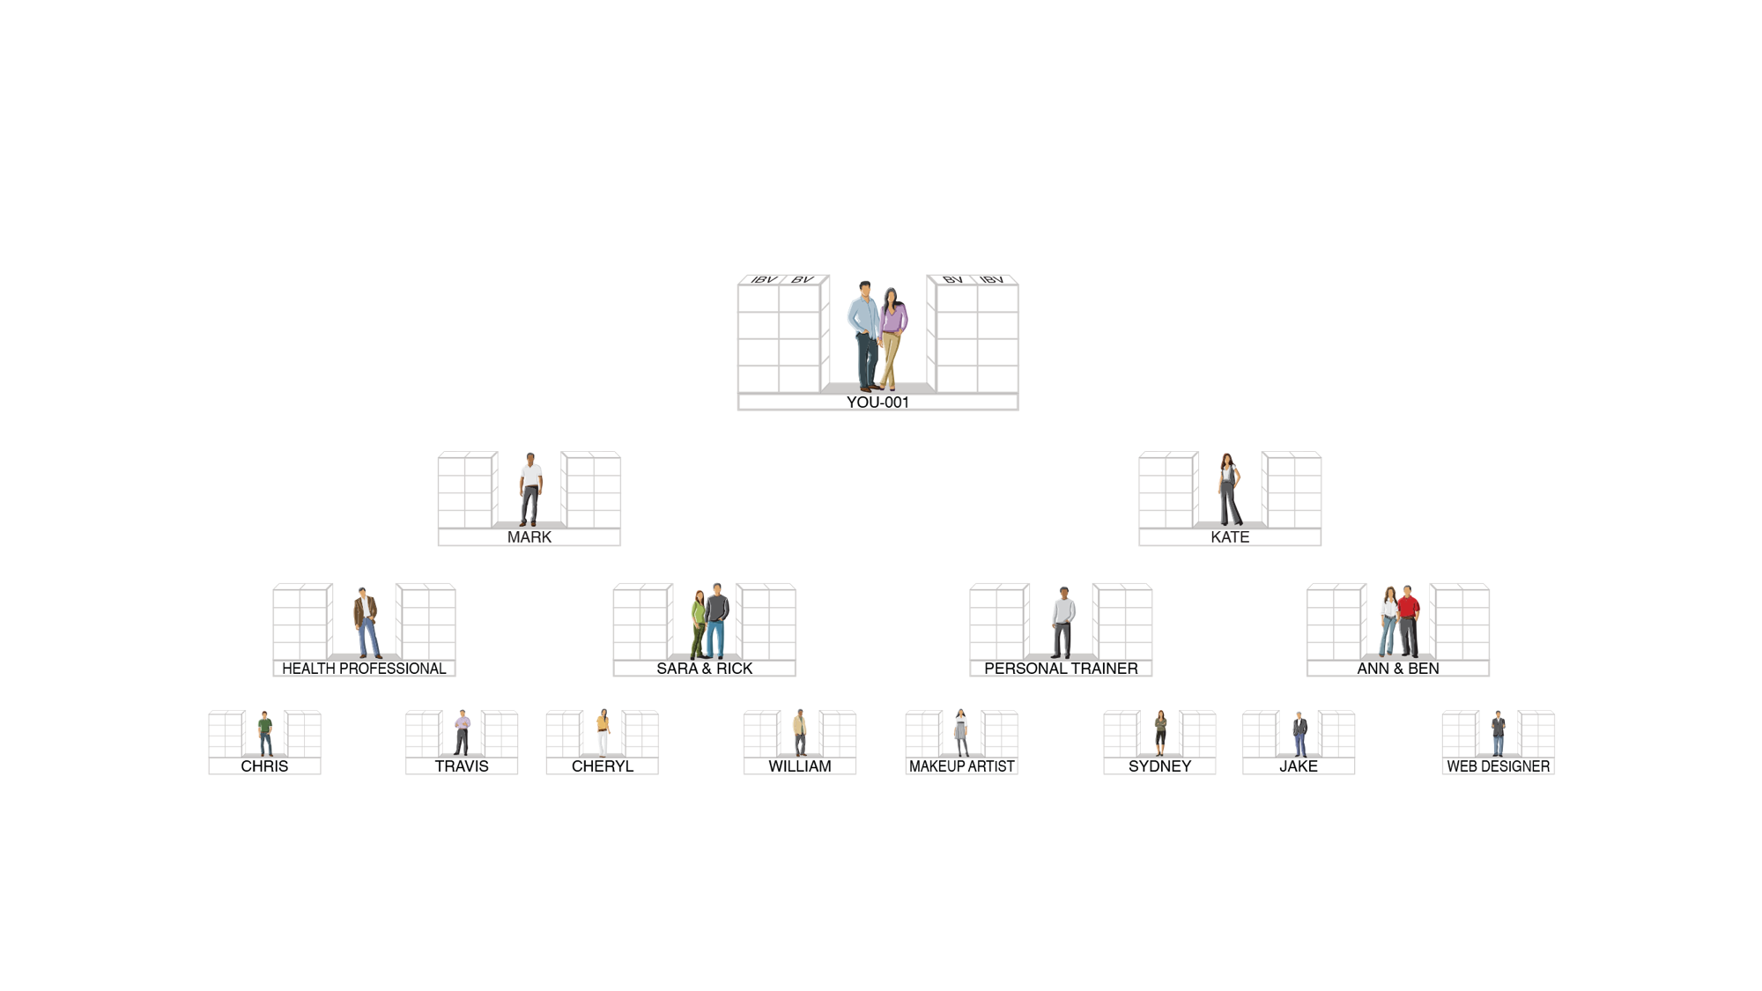
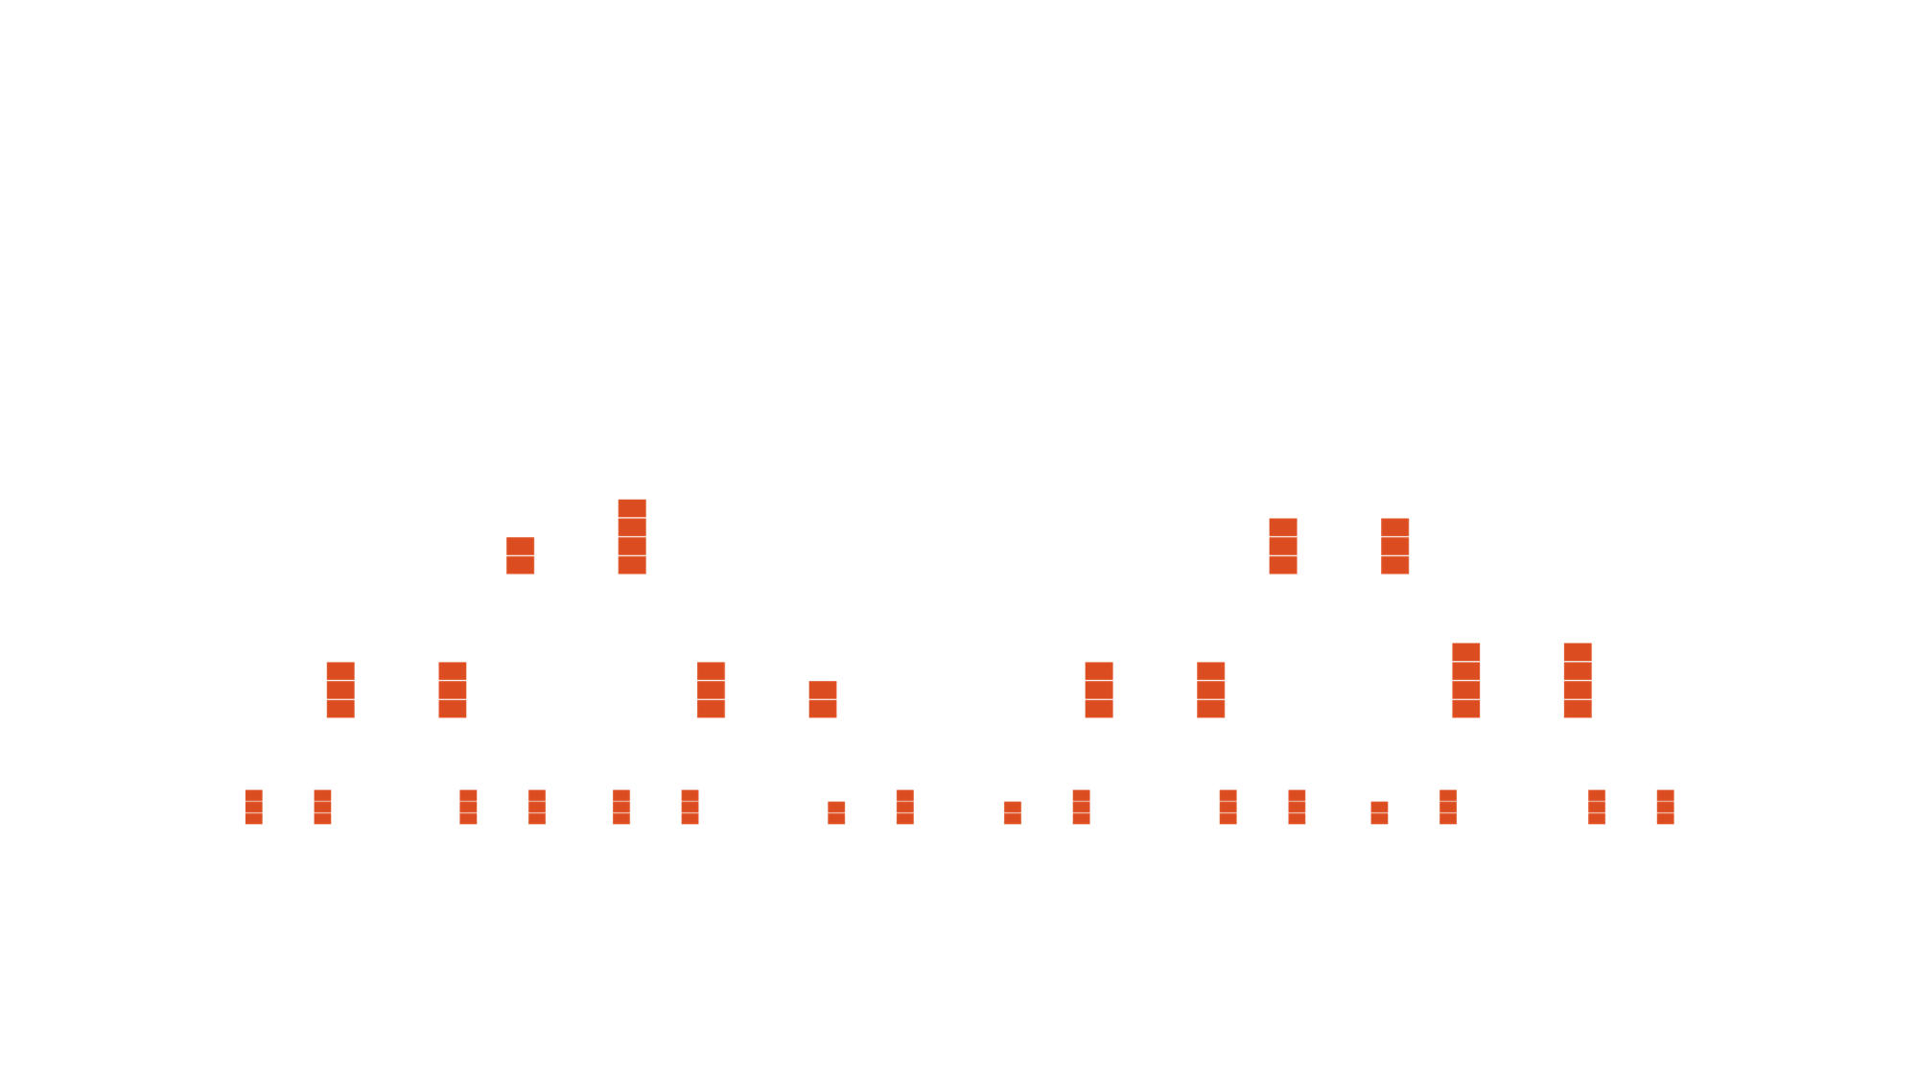









How to earn commission
Daily tracking BV and IBV. Weekly calculating commission.
5000 / 5000 = $4,600
3600 / 3600 = $2,300
2400 / 2400 = $2,300
1200 / 1200 = $2,300
$11,500
5000 / 5000 = $4,600
3600 / 3600 = $2,300
2400 / 2400 = $2,300
1200 / 1200 = $2,300
$11,500
BV
5000
5000
IBV
3600
3600
2400
2400
1200
1200
Health professional
Personal trainer
Makeup artist
Website designer
Each BDC can potentially earn HK$23,000 every week
本簡報中提到的收入等級純屬舉例說明，無意代表美安香港超連鎖™店主的一般收入，也無意表示任何超連鎖™店主皆可賺取同等收入。美安香港超連鎖™店主的成功與否，取決於其在發展事業時的努力、才能與投入程度。
The income levels mentioned in the following presentation are for illustration purposes only. They are not intended to represent the income of a typical Market Hong Kong UnFranchise ™Owner, nor are they intended to represent that any given Independent UnFranchise ™ Owner will earn income in that amount. The success of any Market Hong Kong Independent UnFranchise ™ Owner will depend upon the amount of hard work, talent, and dedication which he or she devotes to building his or her Market Hong Kong Business.

Slide 19
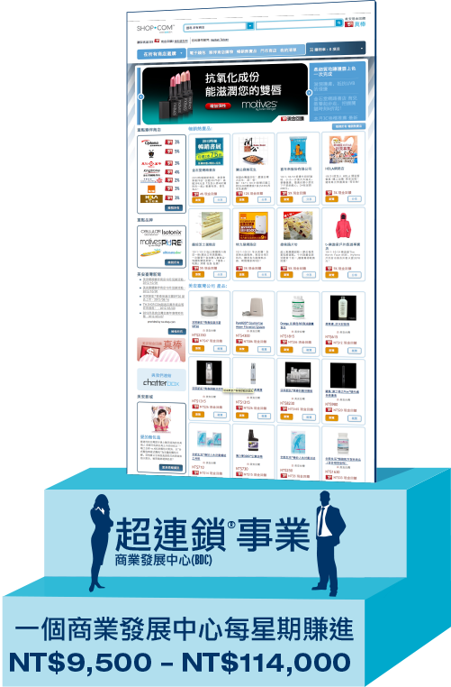
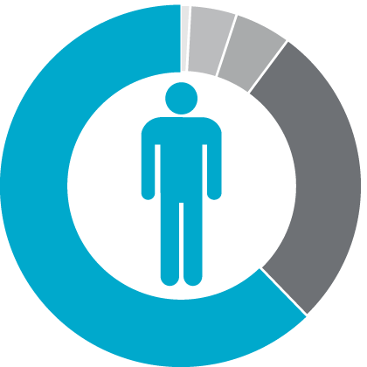
What’s your choice?
Do you believe?
45 years plan
2 - 3 years plan

Slide 20

Reality comes from your ideas
What you can imagine
and believe in
can be achieved

Slide 21
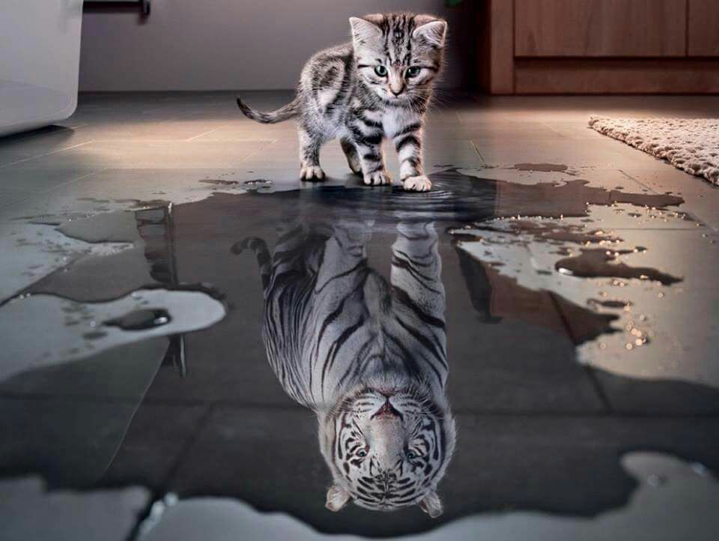
Your desire
is the only limitation to your power

Slide 22
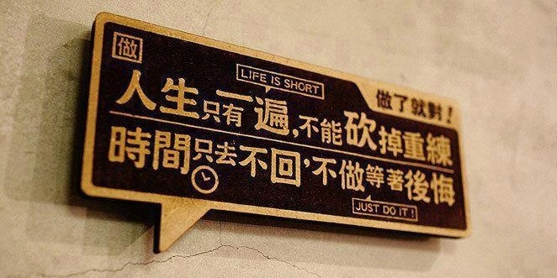
We only live once. We can’t turn back the clock.
Just do it!
Otherwise, regret is right here waiting for us.

Slide 23
Your big why ?

Slide 24
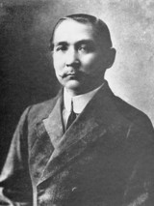
The mindset during these 3 years?
Change
We seek for happiness.
Then we cannot escape from pain.
We call this pain as REVOLUTION !
Sun Yat-sen

Slide 25
During 2~3 year running process...
I kept asking myself a question!!!
How dare…
you…
earning residual income…

Slide 26


Break over your comfort zone

Slide 27

Dream board

Slide 28


Law of Attraction

Slide 29



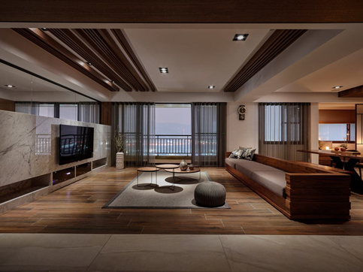
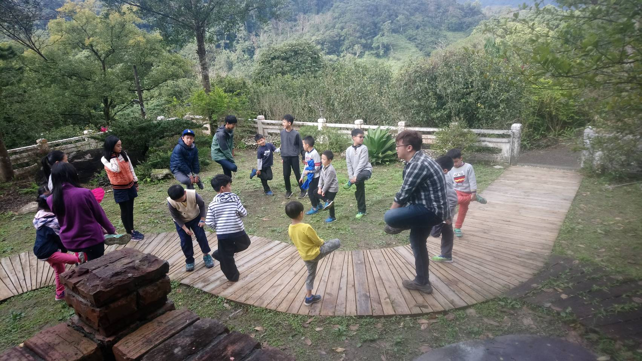
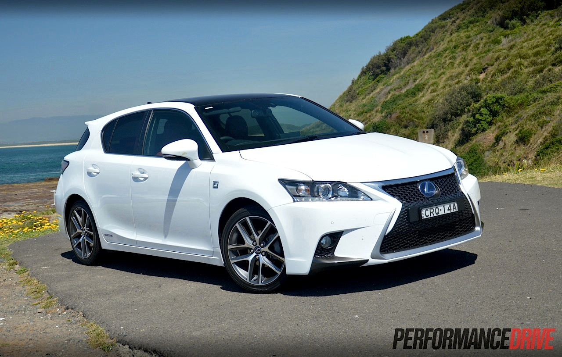
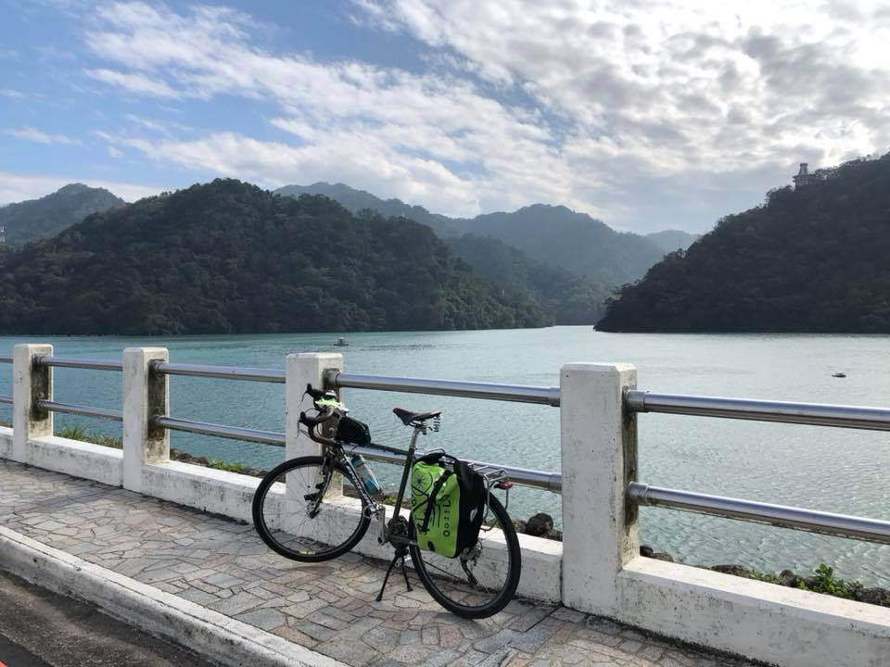
Johnny’s Dream Board (2007)
50
50
the U.S.
the U.S.
1.Life without setting up alarm
2.Owning indirect income
3. My wife and mother will never feel worry
50
50
50
50
6.Safe and comfortable vehicle
7.Do what I want to do(Cycling Around Taiwan)
5.Children study in Forest Elementary School
the U.S.
the U.S.
the U.S.
the U.S.
4.Dream house

Slide 30



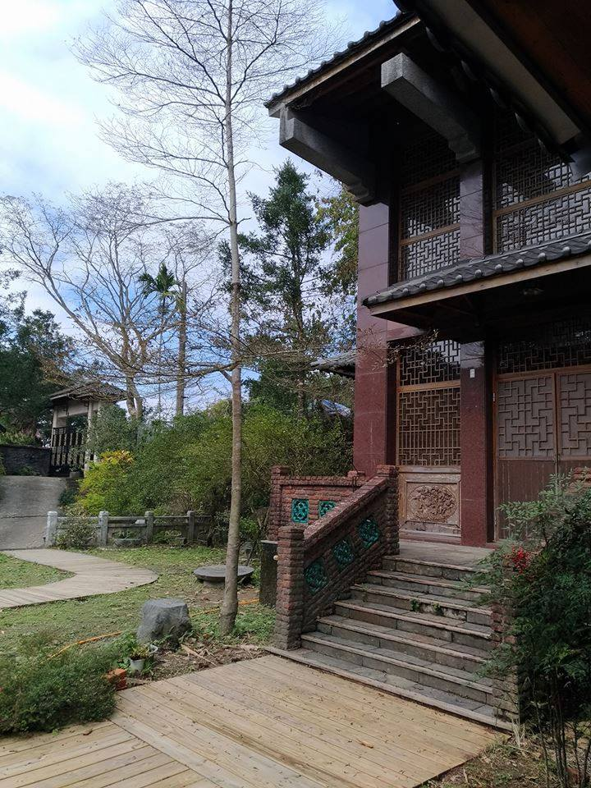
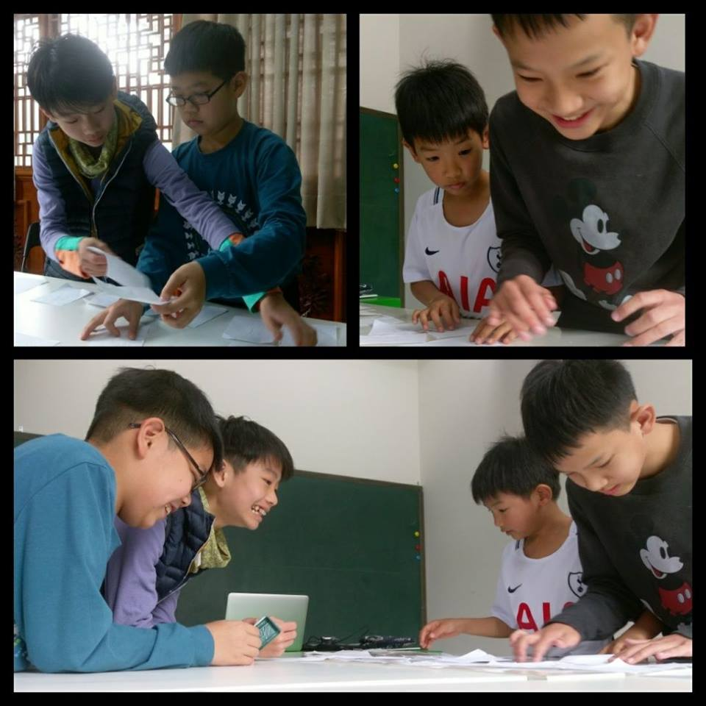
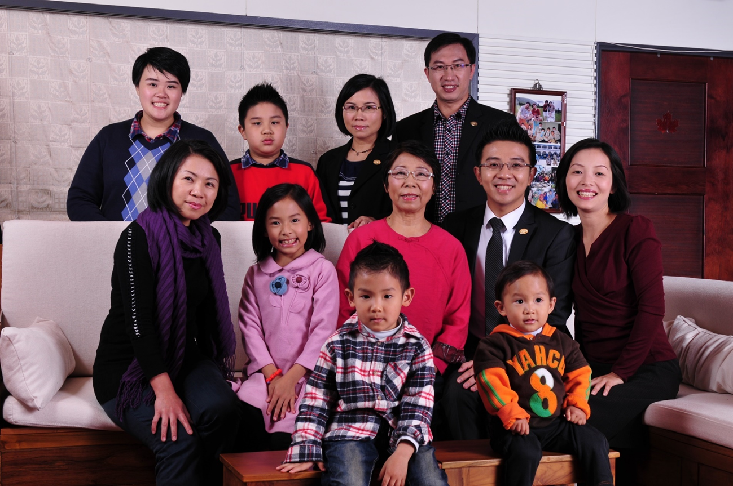



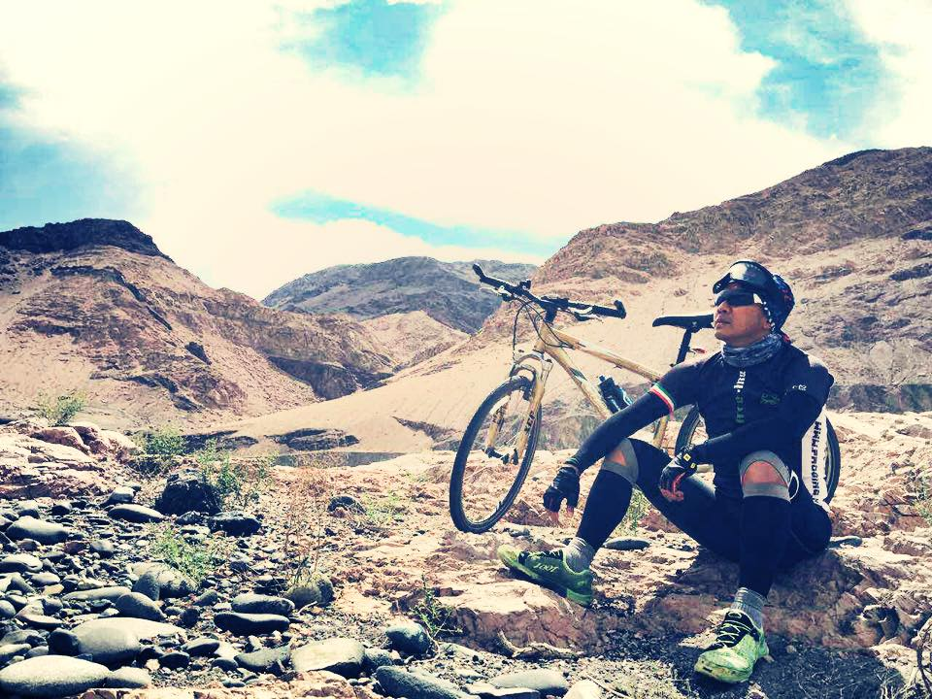
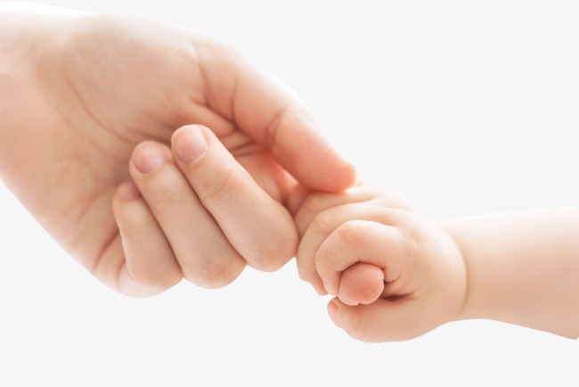
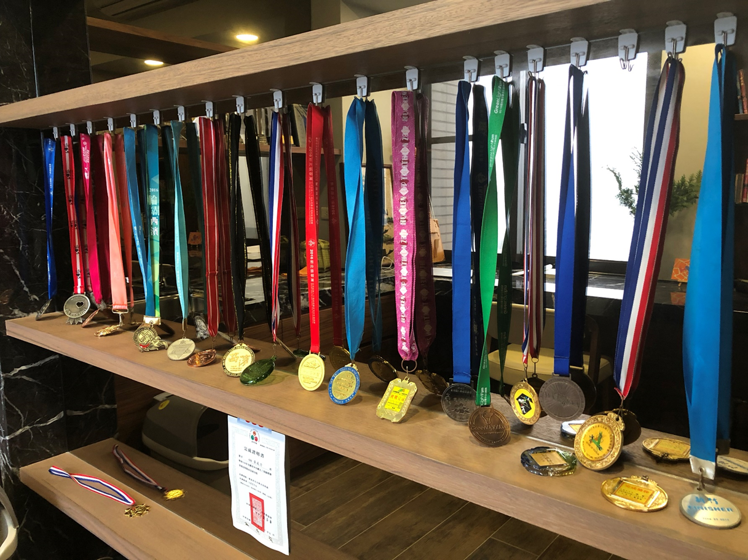
Dreaming
1.Life without setting up alarm
Helping others to change their lives
Staying with children~Establishing a school
Changing my life
Participating community charity
Adopting over 50 children
Taking challenge in Triathlon 113K
Cycling along the silk road
Releasing a book and donating the copyright royalty

Slide 31
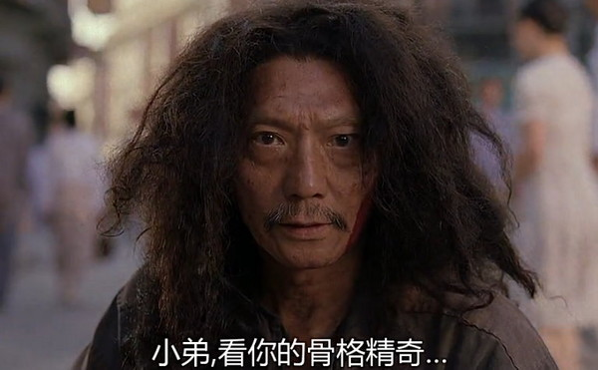
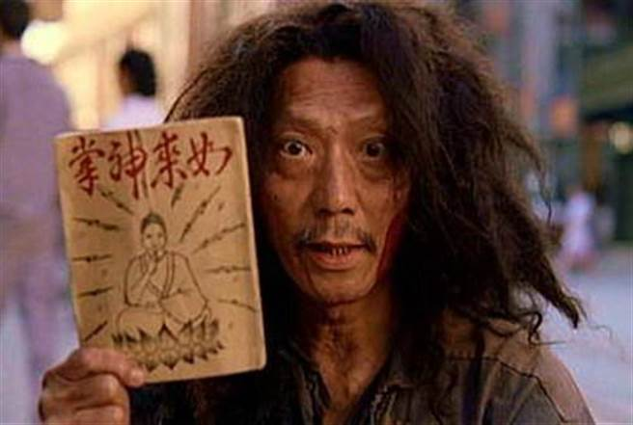
Do you wanna achieve your dream?
Dude, I see your talent.
I have a secret manuscript here for you.

Slide 32

You have to train up yourself
To be a master

Slide 33
for 2-3 years
8-15 hours per week

Slide 34
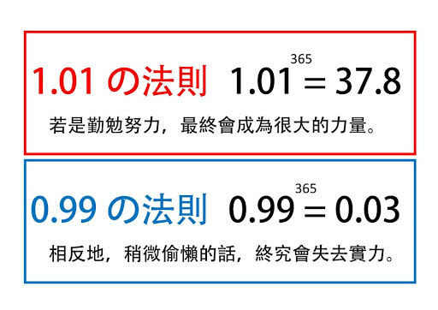
The Power of Insistence
Rule of 1.01
Your effort will turns to big power.
Rule of 0.99
If you slacks off, you will lose your ability.

Slide 35
Goal Setting
(Business plan – 5 steps)
HK$14,375/month HK$57,500 Supervising Coordinator
What kind of target you want to achieve
When to achieve
What you have to pay or what are the difficulties
Detailed successful plan
Write on the paper (Step 1~4) Read twice a day
Within 1~2years
Within 2-3years
Mind Time Money
MUFO, Chairman’s Challenge, Buy and sell tickets
本簡報中提到的收入等級純屬舉例說明，無意代表美安香港超連鎖™店主的一般收入，也無意表示任何超連鎖™店主皆可賺取同等收入。美安香港超連鎖™店主的成功與否，取決於其在發展事業時的努力、才能與投入程度。
The income levels mentioned in the following presentation are for illustration purposes only. They are not intended to represent the income of a typical Market Hong Kong UnFranchise ™Owner, nor are they intended to represent that any given Independent UnFranchise ™ Owner will earn income in that amount. The success of any Market Hong Kong Independent UnFranchise ™ Owner will depend upon the amount of hard work, talent, and dedication which he or she devotes to building his or her Market Hong Kong Business.
Notes:
35
35

Slide 36






Time management & Action plan (8-15 hrs per week)
 | Mon | Tue | Wed | Thurs | Fri | Sat | Sun
Morning
Afternoon
Night

Slide 37


Slide 38

1. MUFO
2. Challenge
3. Tickets
4. Make sure coring training attendees every week
Goal setting~

Slide 39

1.MUFO
Goal setting~
8
+ 8 = 16
(BDC 001)
(BDC 002 ~~)

Slide 40
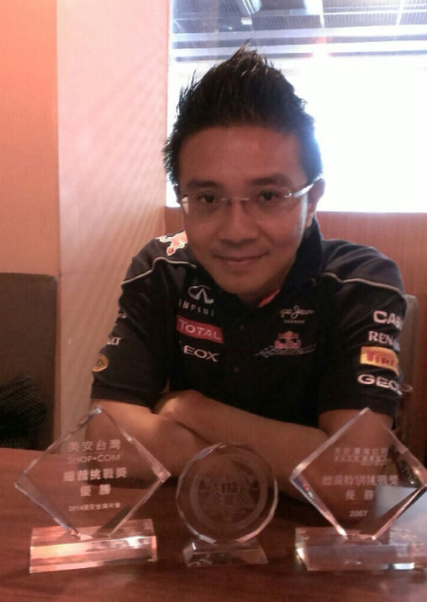
2. Chairman’s Challenge
Goal setting~
Power of “ONCE”

Slide 41
Goal setting~
3. Tickets
My 1st UBP
My 1st LOCAL SEMINAR
My 1st EVENT
2
10
60

Slide 42
Half-year plan
Annual Convention in May
Leadership School in October
KATHERINE YIN
Local Seminar
21/7
Hong Kong Science Park
ALLEN HU
Local Seminar
16/9
Hong Kong Science Park
May
Jun.
Jul.
Aug.
Sep.
Oct.
Nov.

Slide 43
Monthly plan
U
B
P
B5
Team
Coring
U
B
P
B5
Team
Coring
U
B
P
B5
Team
Coring
U
B
P
B5
Team
Coring
1st week
2nd week
3rd week
4th week

Slide 44



Weekly plan
UBP
UBP
Mon
Tue
Wed
Thur
Fri
Sat
Sun
Quantity affects quality

Slide 45
4. Make sure coring training attendees every week
Goal setting~
Coring training is the 2nd important when Events are the most important

Slide 46


Coring Team TRAINING
1. Attend
2. Participate
3. Create your own coring training

Slide 47
Successful 3 year plan
12 months | 11,500
6 months | 11,500
4 months | 11,500
3 months | 11,500
2 months | 11,500
1 month | 11,500
3 weeks | 11,500
2 weeks | 11,500
1 week | 11,500
30 months/3 years | S$126,500元 / 425,500元
The last man standing

Slide 48
MA 2~3 years steps to success
$ $ $ $ $ $ $ $ $ $ $ $ $ $ $ $ $
$27,600/W
Give
$ $ $ $ $ $ $ $ $ $ $ $
$16,100/W
Give
$ $ $ $ $ $ $
$16,100/M
Give
$11,500/M
$ $
Give
Notes:
48

Slide 49


International vision

Slide 50
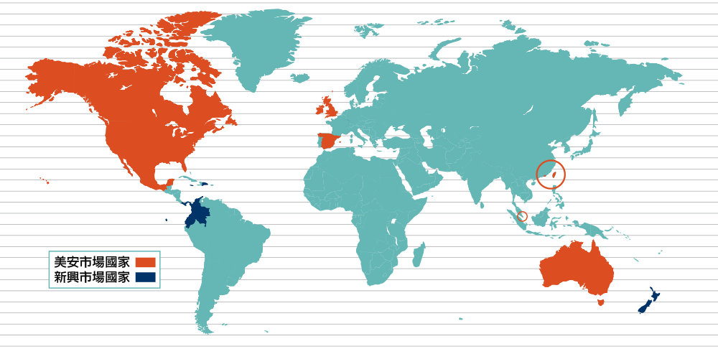
Asia Pacific Integration
MA Markets
Emerging Markets
Business of Market America is all over the world including the U.S., Canada, Mexico, Australia, Taiwan, Hong Kong, England, Singapore and Spain. Emerging Markets includes Bahamas, Columbia, Dominican Republic, Ecuador, Panama, New Zealand and Jamaica.

Slide 51






1 BDC can be approved in 5 Markets
0
Australia 澳洲
Taiwan 台灣
Hong Kong 香港
Singapore 新加坡
Malaysia 馬來西亞

Slide 52
Opening:
2003
2005
2007
2014
2017
Population:
24,526,003
23,642,184
7,379,919
5,728,312
31,722,337
Source: Worldometers

Slide 53

1 BDC can be approved in 5 Markets
1
application
5
90,000,000+
business opportunities

Slide 54
How to earn commission
Daily tracking BV and IBV. Weekly calculating commission.
5000 / 5000 = $4,600
3600 / 3600 = $2,300
2400 / 2400 = $2,300
1200 / 1200 = $2,300
$11,500
5000 / 5000 = $4,600
3600 / 3600 = $2,300
2400 / 2400 = $2,300
1200 / 1200 = $2,300
$11,500
BV
5000
5000
IBV
3600
3600
2400
2400
1200
1200
Health professional
Personal trainer
Makeup artist
Website designer
Each BDC can potentially earn HK$23,000 every week
本簡報中提到的收入等級純屬舉例說明，無意代表美安香港超連鎖™店主的一般收入，也無意表示任何超連鎖™店主皆可賺取同等收入。美安香港超連鎖™店主的成功與否，取決於其在發展事業時的努力、才能與投入程度。
The income levels mentioned in the following presentation are for illustration purposes only. They are not intended to represent the income of a typical Market Hong Kong UnFranchise ™Owner, nor are they intended to represent that any given Independent UnFranchise ™ Owner will earn income in that amount. The success of any Market Hong Kong Independent UnFranchise ™ Owner will depend upon the amount of hard work, talent, and dedication which he or she devotes to building his or her Market Hong Kong Business.

Slide 55
SHOP.COM perfectly presents a 4-win concept
Accelerate the formation of a new economy mode
Market America
Partner
Stores
UnFranchise
Owners
Preferred Customers
5-wins?

Slide 56
Market America
Partner
Stores
UnFranchise
Owners
Preferred Customers
Give back to society

Slide 57


Slide 58

It is not crowded on the way to success
because not many people are willing to insist on

